Slide 1


Henner Services for EMBL Members
26th of April, 2023

Slide 2
Table of contents
1. Key information about Henner
2. Henner’s worldwide Operations offices
3. Your dedicated Client Service Team
4. Your Member documents
5. Your online account
6. Your healthcare journey and reimbursement process
7. Questions & Answers

Slide 3
Henner Group

Slide 4
Key information about Henner
We proudly accompany International Organizations such as EMBL for more than 30 years by providing tailor-made third party administration solutions and medical services for employee benefits plans.
Leading independant administrator
in employee benefits plans worldwide
30 years
of experience with International organizations and non-governmental organizations
24 years
of average client lifetime
30 %
1600
2,1 m
of our activity is performed international
Employees
Insured persons
1,6 m
15 000
95/100
Medical providers worldwide
Of different size companies and organizations
Gender equality index

Slide 5

Henner’s worldwide Operations offices
EUROPE
Spain: Madrid
France: Neuilly-sur-Seine (Paris area)
Portugal: Lisbon
Worldwide offices dedicated to the 24/7 administration of international medical plans
The Client Services Team in charge of the EMBL Health Insurance Scheme is located in Henner’s Lisbon office.
NORTH AMERICA
United States: Boca Raton
AFRICA
Kenya: Nairobi
Tunisia: Tunis
ASIA
Malaysia: Kuala Lumpur
Singapore

Slide 6
Your Dedicated Client Services Team

Slide 7

YOUR DEDICATED TEAM
Who is working for you?
MANAGEMENT TEAM DEDICATED TO EMBL
INTERNATIONAL ORGANISATIONS DEPARTMENT
PARIS
INTERNATIONAL OPERATIONS DEPARTMENT
LISBON
Romain AIGNEL
Head of International Organizations
Ana COSTA
Regional Operations Manager
Guillaume RENAUT
Key Account Manager
Issam Jemaa
Site Operations Manager
Mélanie Mathieu
Key Account Coordinator
Joao NETO
Operations Manager
DEDICATED CLIENT SERVICE TEAM
CST 68
MEDICAL NETWORK DEPARTMENT
ACTUARIAL DEPARTMENT
6 languages spoken (English, Spanish, French, German, Portuguese, Dutch)
LEGAL DEPARTMENT
IT DEPARTMENT

Slide 8




Your dedicated Team
One team to answer all your questions
A polyvalent and multilingual Client Services Team dedicated to the administration of EMBL’s Health Insurance Scheme.
Our Client Services Officers are trained on all aspects of your health insurance cover.
Member reimbursements
Questions on cover
Direct payment
Prior agreements
Direct Billing
Assistance with online tools
Hospitalisations
Questions on procedures
Phone (toll-free): 00 800 2020 2022
If toll-free number not available: +351 211 233 803
Email: embl@henner.com
24/7, 365 days per year
(outside of office hours, call is forwarded to another Henner office)

Slide 9
YOUR MEMBER DOCUMENTS

Slide 10
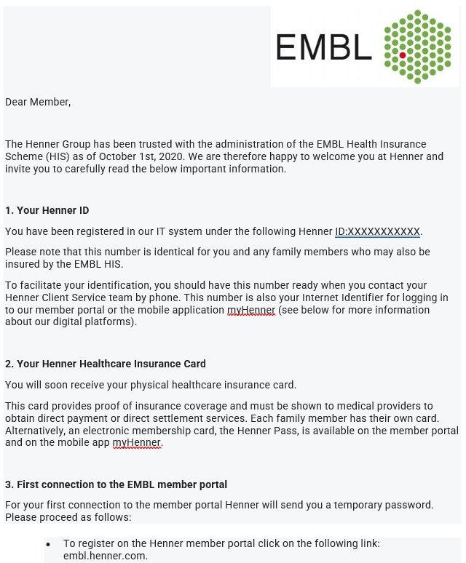


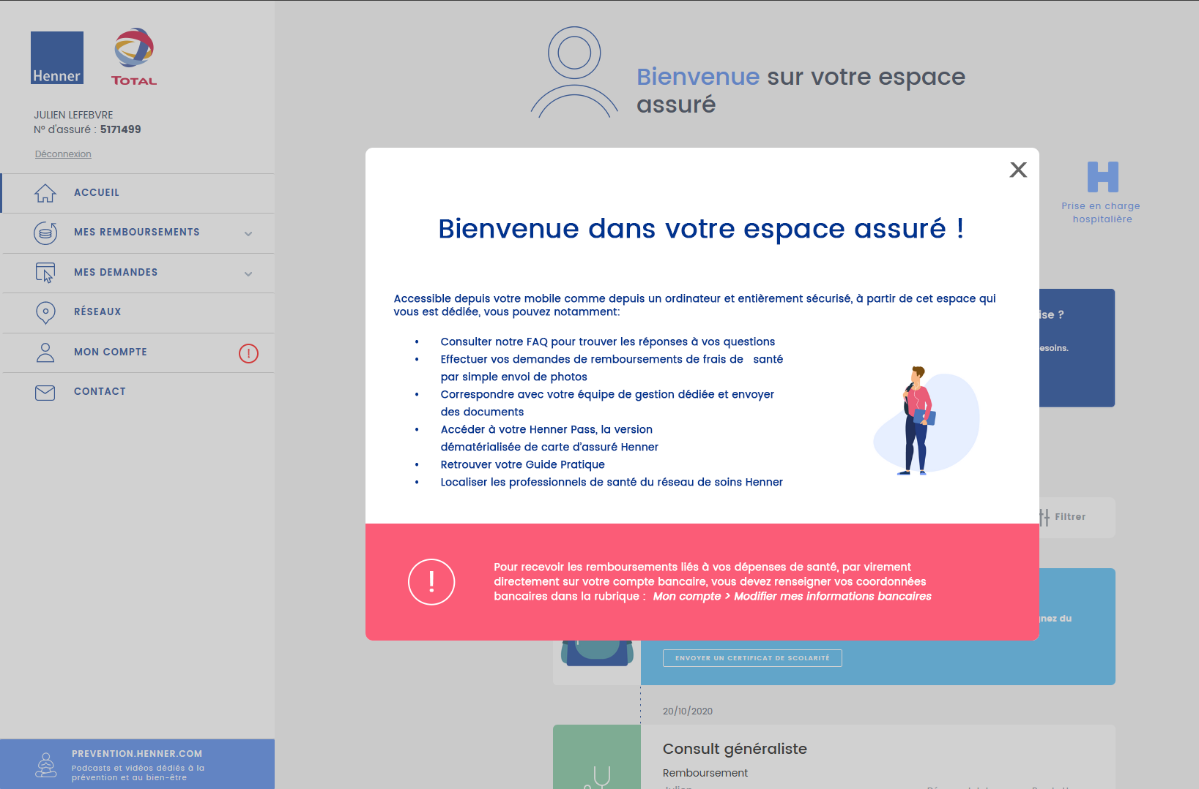


Your Member documents
Henner will send you a Digital Welcome Kit which contains a welcome email and all information required to connect to the digital tools and access the Henner services & documents.
WELCOME EMAIL
1
Communicate Henner Identification Number (ID)
Share key information
Encourage discovery of Henner services
Fully digital
Information sent easily wherever the insured is in the world
Henner Pass
Direct access to the digital insurance card from the web portal or the mobile app
MEMBER PORTAL
2
Make the first connection
Access features and services
Consult your table of benefits
Update your information and data
Manage your first procedures and claims
Membership documents
Including your Membership guide detailing your health cover, procedures and information on digital tools
Note that Henner receives newcomers’ email addresses from EMBL through the daily data exchange. They should expect to receive their welcome email within 10 days from joining EMBL.
Delays may be caused by data entry pause during active payroll period by HR, or rare technical failures. Newcomers are advised to contact Henner directly and/or their EMBL HR focal point.

Slide 11
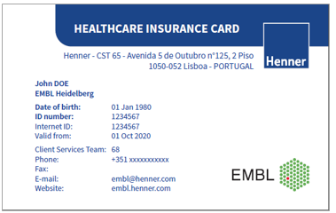
Your Member documents
Henner will also send you a Physical Welcome Kit, which contains your Healthcare Insurance card.
Contact details of your Client Service Team
Your Henner ID
URL of Henner website

Slide 12
YOUR Online account

Slide 13
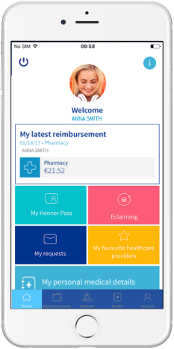

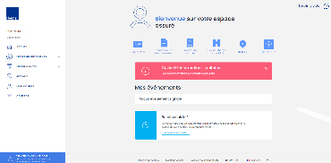











Your online account
User friendly digital tools with access to all essential features
Mobile application:
Member portal:
embl.henner.com
Henner Pass
Digital membership card
E-claiming
Upload medical invoices
Track the status
Explanations of benefit
Medical provider search
Search and geolocate medical providers by country, city, specialty
Online messaging
Secure communication
Send a document/request
Submit invoices to be directly paid to a medical provider (Direct Payment)
Send prior agreement requests
Ask for a letter of guarantee
In case of a scheduled hospitalisation
Consult member documents
EMBL Membership guidelines
Table of benefits
Insurance certificates
Statistics
Access to personal medical expense statistics

Slide 14


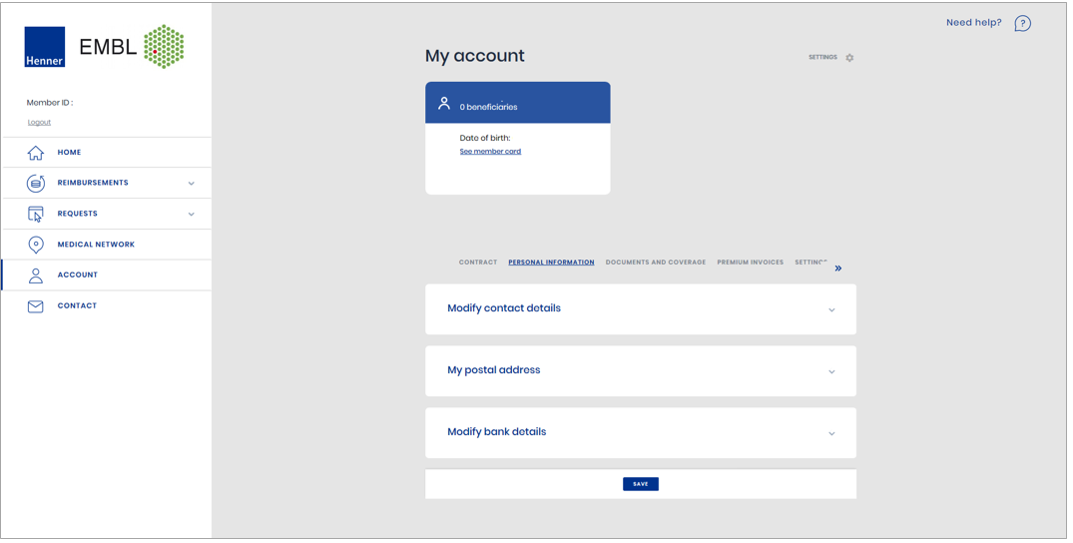
Your online account
Please verify your bank details and email address
You can also send your request by post
Dedicated website:
eml.henner.com
One single page to find all your personal information, your membership guide and change your contact and bank details
Request a reimbursement
Search a medical provider
in the Henner network

Slide 15
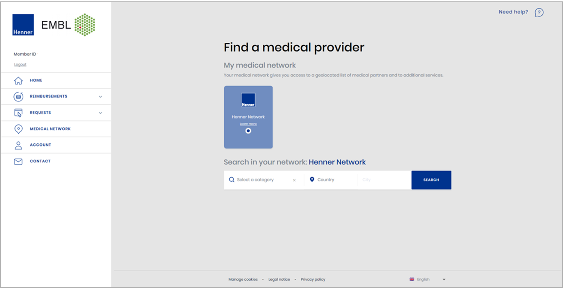
Your online account
You can also send your request by post
Dedicated website:
eml.henner.com
Search for a medical provider in the Henner Network
Request a reimbursement
Search a medical provider
in the Henner network

Slide 16
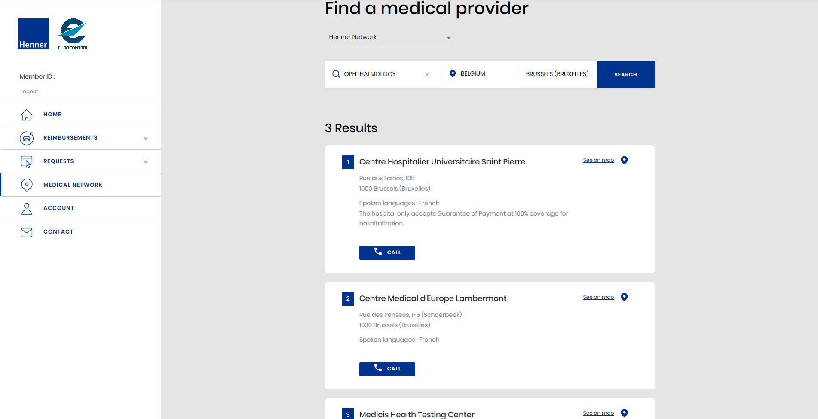
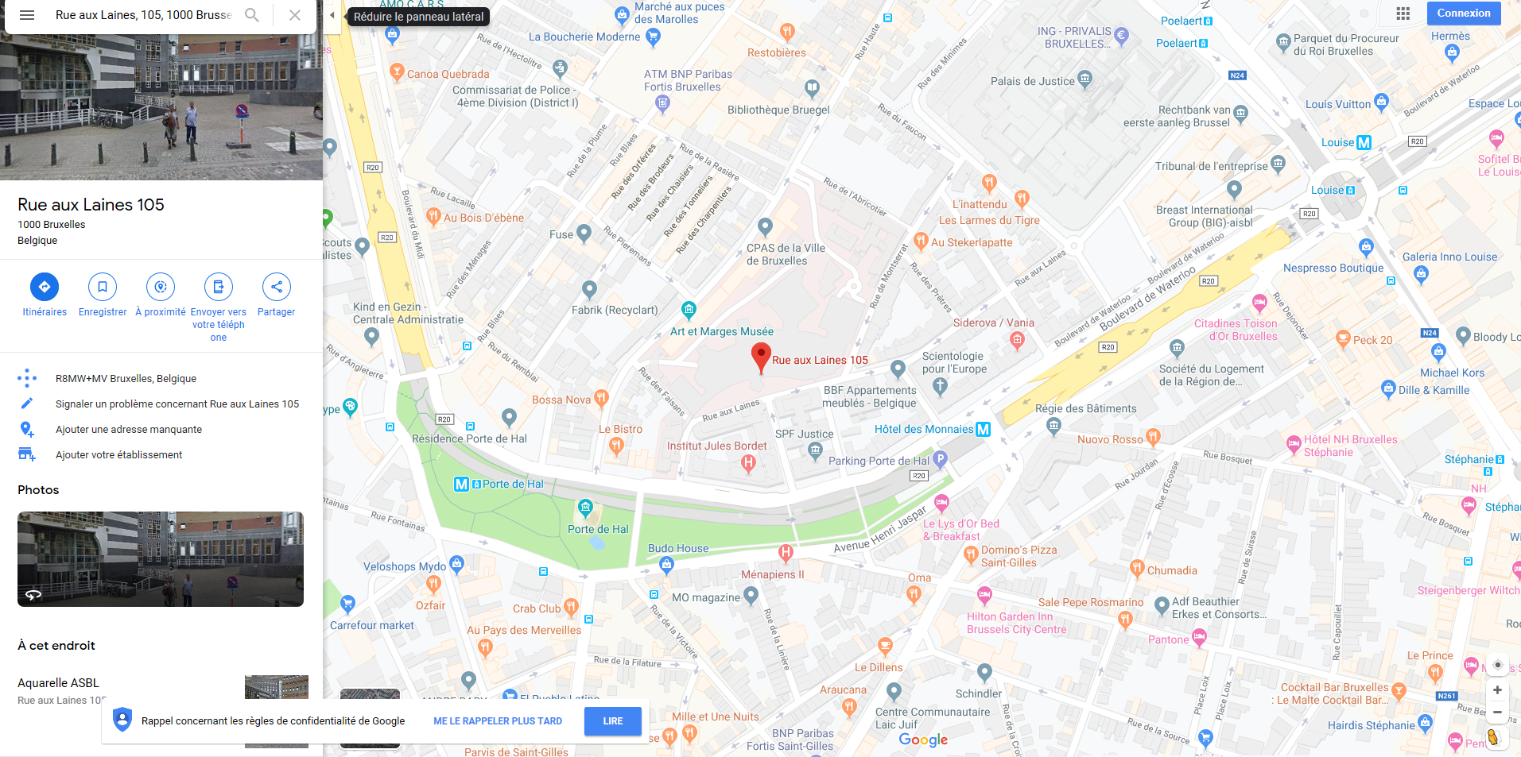
Your online account
You can also send your request by post
Dedicated website:
eml.henner.com
Search for a medical provider in the Henner Network
Request a reimbursement
Click on “See on map”
Search a medical provider
in the Henner network

Slide 17
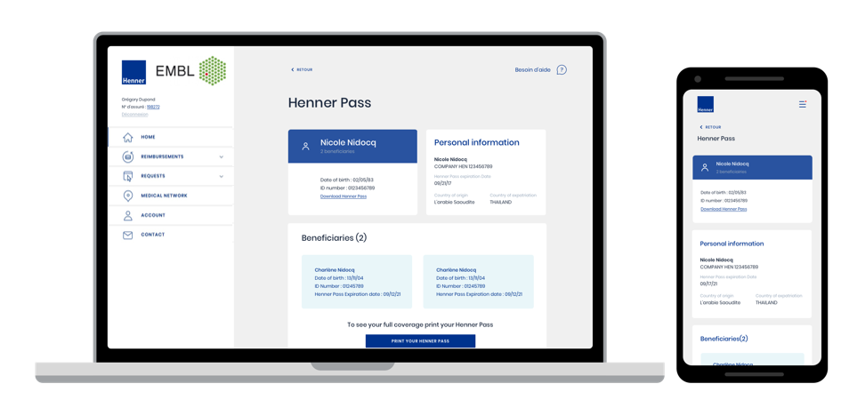
Your online account
You can also send your request by post
Dedicated website:
eml.henner.com
Access your digital insurance card, the Henner Pass
Request a reimbursement
Search a medical provider
in the Henner network
Access your Henner Pass via the Mobile application and the Henner website
The Henner Pass is your digital healthcare insurance card (also available offline on the member application)

Slide 18
Your online account
You can also send your request by post
Dedicated website:
eml.henner.com
Access your Membership Guide
Request a reimbursement
Search a medical provider
in the Henner network
Details of your health cover (table of benefits)
Procedures (claim submission, hospitalisations)
Information on online tools (website, mobile app)

Slide 19


Member’s journey
Member will receive a reply within 5 working days
QUALITY MONITORING
Complain process
A complaint is any expression of dissatisfaction with an action or lack of action relating to a service provided by Henner, whether justified or not
A complaint may be expressed by email, postal mail, phone call, through a satisfaction survey, via the Henner website, during an interaction with a sales representative…
Phone (toll-free): 00 800 2020 2022
If toll-free number not available: +351 211 233 803
Email: embl@henner.com

Slide 20
Member’S Journey
Claims & Guarantees of Payment

Slide 21



Member’s journey
You can also send your request by post
Dedicated website:
eml.henner.com
Three processes
To benefit from the Health Insurance Scheme
Request a reimbursement
Pay and claim
Direct billing
Direct payment
Visit to the medical provider
Invoice is paid to the medical provider by the member
The member sends the invoice and confirmation of payment to Henner
Henner processes your claim within 5 working days
The payment is transferred to the member’s bank account between 3 and 10 days depending on the bank transfer delay
An important medical procedure is planned
The member asks Henner to contact directly the medical provider in advance
Henner issues a Guarantee of Payment and sends it to the medical provider
Once the procedure performed, the medical provider sends the invoice directly to Henner
Henner pays to the medical provider
The member visits a medical provider
The member sends the invoice to Henner
Henner pays directly the medical provider
In case of a co-pay, Henner request the co-pay share to the member
The member pays the co-pay share to Henner
Search a medical provider
in the Henner network

Slide 22


Member’s journey
These channels are compliant with data protection regulations
Dedicated website:
eml.henner.com
QUALITY MONITORING
Send your claims via:
Preferred options
Other options
Henner
Member Portal
Henner
Mobile App
Email Postal mail
EDI
Members can send their claim by post to the address of their dedicated Client Service Team
Claims can also be received by EDI (Electronic Data Interchange) for members who are in complement of the:
French Social Security
Caisse des Français à l’Etranger
Claims MUST be submitted within 2 years from the date of care as stated on the invoice.
Original invoices must be kept and can be
requested by Henner

Slide 23
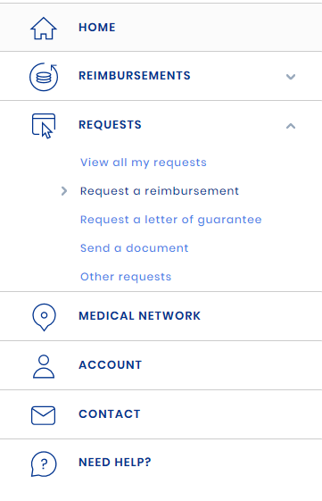
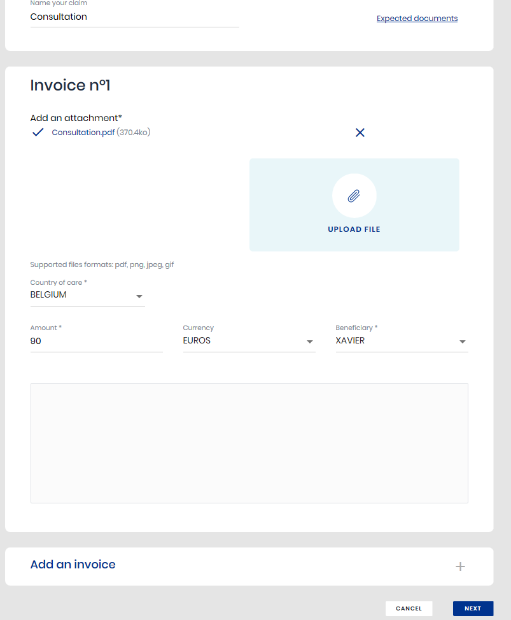
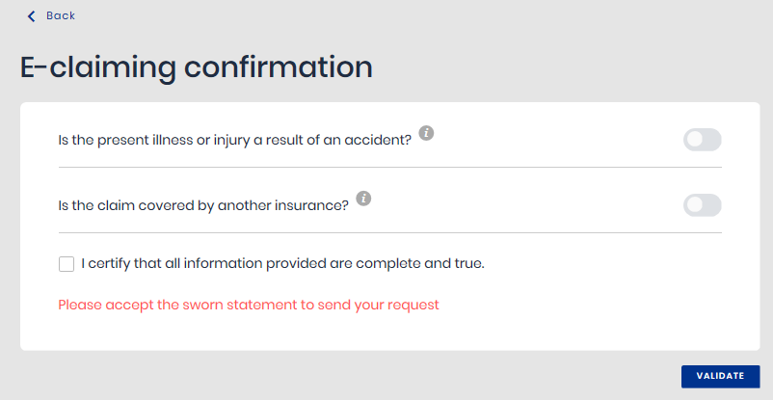
Your online account
You can also send your request by post
Dedicated website:
eml.henner.com
Request a reimbursement online
1
2
3
Click on “Ask for a reimbursement”
Complete the online form and attach documents
(invoices, medical prescription, etc.)
Check the requested information and validate
Request a reimbursement
Once your reimbursement request has been processed, you will receive a notification.

Slide 24






Member’s journey
QUALITY MONITORING
Standard Claims Procedure – Online E-claiming Process
A confirmation email is sent to the member
The member logs in to his/her online member portal on the dedicated Henner Website/Mobile App
The member creates an online reimbursement claim + upload the scan /picture of necessary supporting documents
A reimbursement claim is automatically created in Henner IT system
1
2
3
4
Scan/picture documents are reviewed, and the statement is processed in Henner IT system
7
6
5
Henner sends an email to the member about the availability of the Explanation Of Benefits on his/her online member portal
Henner issues payment to the member’s bank account
Status changes to « processed » on the online member portal

Slide 25

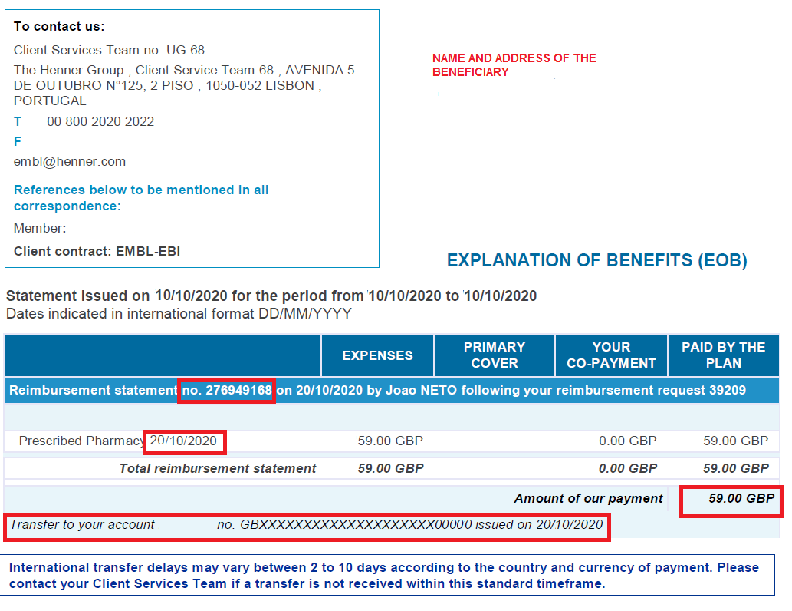
Member’s journey
You are informed the day the claim is processed your EoB is available to be downloaded.
You can see it on the member portal under « Reimbursements – View my reimbursements ».
You can also send your request by post
Dedicated website:
eml.henner.com
Your Explanation of Benefits
For Reimbursement claims
Request a reimbursement
EoB reference
Date the medical procedure has been performed
Total amount paid
Bank account reference to which the payment has been processed and the date of processing
Search a medical provider
in the Henner network

Slide 26





Member’s journey
Standard Claims Procedure – Emergency Hospitalisation
* No prior agreement is required for first 3 days of emergency hospitalisation
The member is admitted
to the hospital/clinic for a medical emergency
A family member or the hospital/clinic contacts Henner within 48 hours to declare the hospitalisation
1
2
3
Henner issues
a Guarantee of Payment,
within 2 hours, valid for 3 days
6
5
4
Henner pays the invoice to the medical provider
The medical provider sends the invoice to Henner
After 3 days of hospitalisation,
authorization procedure is required to extend the inpatient stay

Slide 27


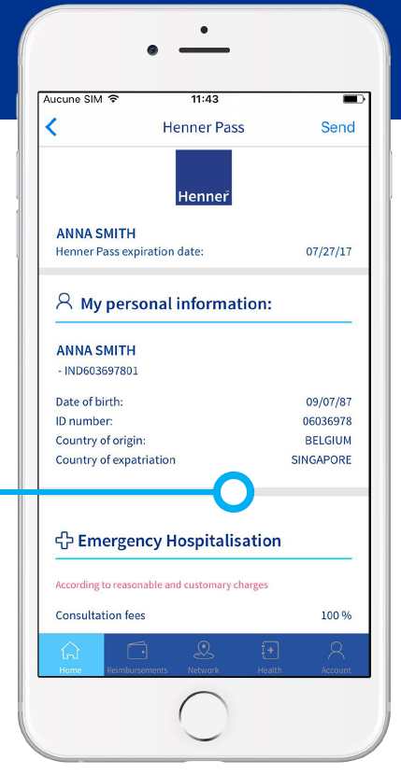


Member’s journey
Standard Claims Procedure – Scheduled Hospitalization
* A Prior Agreement is mandatory for scheduled hospitalisations
The member shows his/her member card to the medical provider
A Prior Agreement* form is completed and sent to the Henner medical team for approval
Henner issues a Guarantee of Payment within 5 working days to the medical provider + a copy is sent to the member
1
2
3
4
The medical provider delivers appropriate treatment
7
6
5
Henner pays the invoice to the medical provider
The medical provider sends the invoice to Henner
The member pays his/her co-pay (when applicable) to the medical provider

Slide 28

Direct Payment Process
No control over delay
Delay controlled by Henner
Member required medical treatment and goes to provider of choice
Medical provider delivers appropriate treatment
Medical provider sends invoice to member
1
2
3
4
Member submits invoices through Henner portal
7
6
5
Direct Payment EOB available on member’s portal
Henner send EOB to provider confirming payment
Henner pays the invoice to the medical provider

Slide 29
Member’s journey
You are informed overnight that your EoB is available to be downloaded.
You can see it on the member portal under « Reimbursements – View my reimbursements ».
Your Explanation of Benefits
QUALITY MONITORING
For Direct Billing claims

Slide 30
Treatments not covered at 100% or which have ceillings
CODE | Type of Treatment
PAU | Hearing Aids
FIV | Fertility Treatment
IMP | Dental Implants
PD | Dental Prostheses
TO | Orthodontic Treatment
AMK | Physical Therapy
SC | Routine Dental Treatment (eg: Cleaning)
LER | Contact Lenses
AAC | Medical Material/Accessories (eg: Wheelchair)
VER | Glass Lenses
OR | Orthopedic appliances
ML | Glass Frames

Slide 31


QUESTIONS & ANSWERS
Henner, SAS de gestion et de courtage d'assurances - Capital de 8 212 500 € - RCS Nanterre 323 377 739 - TVA intra-communautaire FR 48323377739 - Immatriculation ORIAS n° 07.002.039 (www.orias.fr) - Relevant du contrôle de l’ACPR (61 rue Taitbout - 75436 Paris Cedex 09, www.acpr.banque-france.fr) - Entreprise certifiée ISO 9001 par Bureau Veritas Certification - Siège social : 14 bd du Général Leclerc, 92200 Neuilly-sur-Seine, France - www.henner.com - Réclamations : consulter la rubrique Réclamations sur www.henner.com

